Slide 1
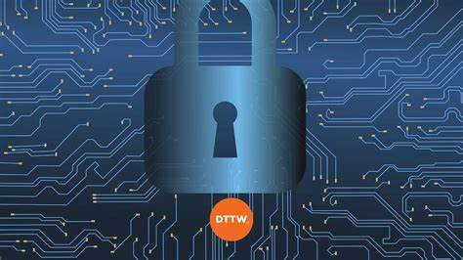
CYBERCRIME
Gokce Gercek
19141321

Slide 2

Cybercrime is any illegal activity done by using computers and networks that targets individuals or organisations.
Since the computers are at the centre of our lives, cybercrime is gaining more importance and increasing in scale and complexity.

Slide 3
Types of Cybercrimes
Phishing is using forged messages to achieve personal information. It is done with using a fake e-mail address and website. Phishing uses the victim’s trust to lure them into clicking a dangerous link that would enable the criminal to achieve sensitive information which can then be used either by the criminal or sold to third parties for cash.
Stealing/misusing personal information (identity fraud) happens when criminals use someone else’s name, credit cards, ID number or passport details without getting their permission. The motive behind identity theft could be financial as well as intending to damage a victim’s reputation.
Hacking is gaining unauthorised access to devices like computers, smartphones, tablets, and even entire networks to compromise them. Hackers motivation can be financial, political, spying or simply just having fun.

Slide 4
Promoting terrorism related acts is also a cyber crime as this is happening in an online environment. Criminals seek to recruit people for terrorist organisations by brainwashing them using computers.
Email and internet fraud is done by cybercriminals to steal data and money by using refined methods. For example, you get an email from a senior manager asking you to buy gift cards or you receive a text saying you’ve won a prize and you need to transfer funds to an account to be able to get the prize! Main motive of the criminal in e-mail and internet fraud is financial gain.
Theft of financial or card payment data is basically an act of transferring money by using a stolen credit card or unauthorised payment information. Criminals get data in various ways such as card scanning at ATMs or ticket machines and also phishing.

Slide 5

Theft and sale of corporate data is mostly for financial gain. Criminals use company’s vulnerabilities in security to access sensitive data and sell it to third parties. Criminals take advantage of faulty networks, weak passwords, unpatched servers, publicly available information or insider threats. One of the biggest data breaches happened when a criminal forged cookies to get into user’s accounts without needing passwords. Yahoo’s 500 million customers were impacted.

Slide 6
Cyberextortion happens when a target company is threatened by criminals stating they will shut down, interrupt their operations, or share confidential data until they receive a payment. It consists of two types of cybercrime; ransomware or DoS.
Ransomware is designing a malware that denies a user or organization access to their files on their own computer. Criminals encrypt the data and ask for ransom to give the encryption key back to the victims. The quicker the payment is made, the lesser the amount to pay.
DoS(Denial of Service) is shutting down a network or machine and making it inaccessible to is users by overwhelming and flooding the target with traffic. The server of the system gets too busy to deal with all this traffic and forces it to shut. Ping of death is a DoS attack that took advantage of old technology in 1990s. It sent too many of the pings which would crash an older system.

Slide 7


Cryptojacking is using someone else’s computer to mine cryptocurrency without their authorization. Financial gain is the main motive of cryptojacking. In 2019, the Microsoft store deleted 8 apps that were mining cryptocurrency illegally.
Cyberespionage is accessing sensitive information by using computer networks and resources without authorisation. Governments and organisations are targeted, as well as individuals.

Slide 8
The Affects of Cybercrime
Cybercrime can affect individuals by causing them financial loss, reputational damage and can adversely impact their health. Malware and virus attacks can lead to identity theft and cause important files and photos to get damaged or lost.
Organisations can suffer from cyber crime through financial loss, disruptions to their operations and damage to their reputations.
Governments can also be adversely affected by cybercrime such as the manipulation of election campaigns and the release of sensitive information.
Cybercrime costs the global economy around $445bn every year. Individuals aged 18-34 are the most impacted by cybercrime such as suffering from social media hacks and ramsomware.

